Slide 1




For more than 20 years, Duarte has developed visual stories for the world’s leading corporate brands, thought leadership forums, and an Academy
Award-winning documentary.
Now they bring you…
FIVE RULES FOR CREATING GREAT PRESENTATIONS
Notes:
To view this presentation, first, turn up your volume and second, launch the self-running slide show.

Slide 2


To View This Presentation
FIRST
Turn Up Your Volume
SECOND
Launch Self-Running Slide Show
Notes:
To view this presentation, first, turn up your volume and second, launch the self-running slide show.

Slide 3








Notes:
Presentations are a powerful communication medium.

Slide 4

Notes:
For more than 20 years, Duarte has developed presentations…

Slide 5



D
Notes:
…to launch products,

Slide 6


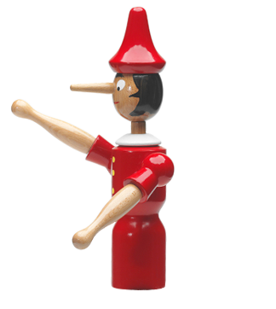


Notes:
…align employees,

Slide 7
Notes:
…increase company value,

Slide 8

Notes:
…and propel

Slide 9














Notes:
…global causes.

Slide 10




5
RULES
Notes:
Along the way we’ve discovered…

Slide 11
5
RULES
FOR
WORLD
CREATING
PRESENTATIONS
CHANGING
Notes:
…five simple rules for creating world-changing presentations.

Slide 12

TREAT
YOUR
AUDIENCE
KING
AS
Notes:
The first rule is: Treat your audience as king.

Slide 13
















Notes:
Your audience deserves to be treated like royalty. Design a presentation that meets their needs, not just yours.

Slide 14
WHY
WHY
THE
THE
THEY
THEY
WHAT
WHAT
STEPS
STEPS
YOU
YOU
THEY
THEY
NEED
NEED
TO
SHOULD
TO
SHOULD
ADOPT
ADOPT
YOUR
YOUR
FOLLOW
FOLLOW
CAN
CAN
DO
DO
FOR
FOR
THEM
THEM
TO
TO
TAKE
TAKE
VIEW
VIEW
ACTION
ACTION
Notes:
Audiences want to know what you can do for them, why they should adopt your view, and the steps they need to follow to take action.

Slide 15
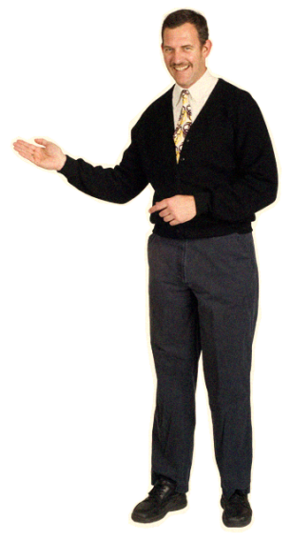
$
Notes:
Give them those things in a clear, easily understandable way…

Slide 16






Notes:
…and you will undoubtedly find favor with the king.

Slide 17

2
SPREAD
IDEAS
AND
MOVE
PEOPLE
Notes:
The second rule is: Spread ideas and move people.

Slide 18
BLAH
BLAH
BLAH
BLAH
BLAH
BLAH
BLAH
Notes:
Your audience didn’t show up to read your 60 page on screen dissertation.

Slide 19
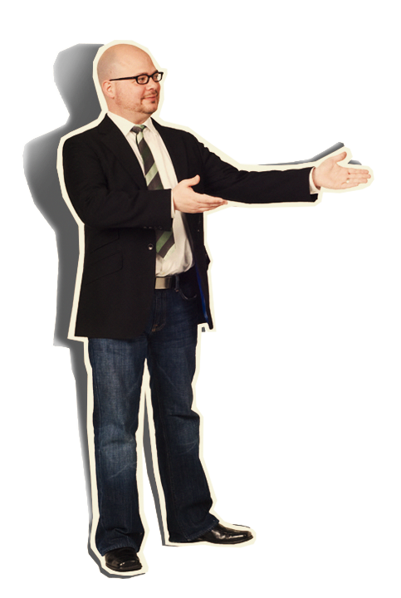



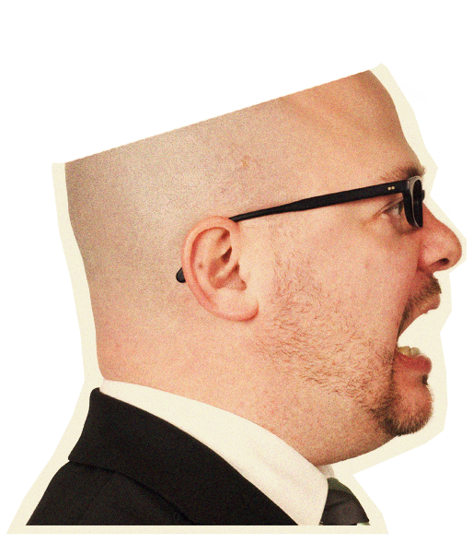


Notes:
They’re there to see you. To be inspired by your message…

Slide 20
Notes:
…and witness the quality of your thought.

Slide 21
AN
OTHER
ME
ET
ING
Notes:
You are not giving your presentation to have another meeting. You are there to covey meaning.

Slide 22



Notes:
So, consider including imagery that powerfully illustrates your point.

Slide 23





Notes:
Sometimes moving images can inspire in a way that static slides cannot. A slow moving animation creates a sense of nostalgia.

Slide 24





WHICH
PRODUCT
HAS
IT
ALL?
Notes:
A sequential build adds a sense of suspense.

Slide 25

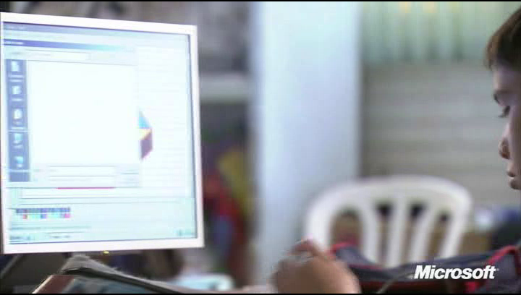
Notes:
And a thought-provoking video moves your audience in a way that can change not only minds, but hearts.

Slide 26



3
HELP
THEM
SEE
WHAT
YOU
ARE
SAYING
Notes:
The next rule is: Help them see what you are saying.

Slide 27


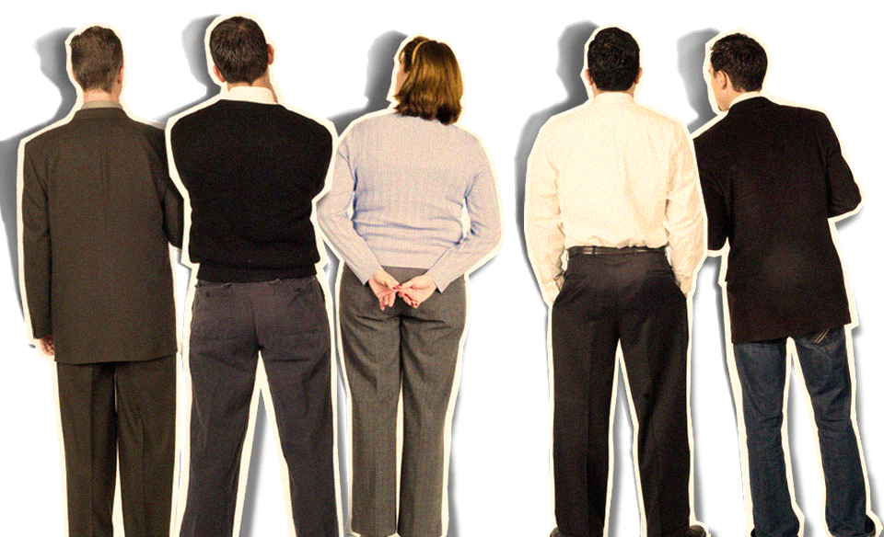

Notes:
Half of the people in your audience are verbal thinkers and the other half are visual.

Slide 28

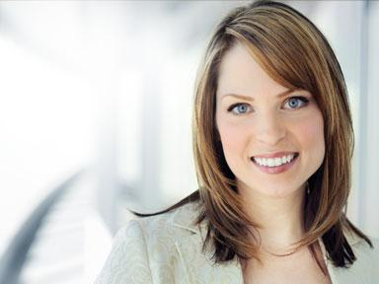









Notes:
Combining minimal text with meaningful visuals means that you’ll reach everyone.

Slide 29
Notes:
Brainstorm graphics that will effectively communicate your message…

Slide 30




CANS
THE
RECYCLED
PROCESS
= 1000 CANS
JANUARY
FEBRUARY
MARCH
Notes:
…and replace those words with a picture, chart or diagram. Then apply a consistent treatment to your graphics to give your whole presentation a unified look so that your audience is attracted to, rather than distracted from, your message.

Slide 31










4
PRACTICE
DESIGN
NOT
DECORATION
Notes:
Rule number 4: Practice design, not decoration.

Slide 32
Notes:
As tempting as it is to fill your slides with stuff, often de-decorating is the best policy.

Slide 33


Notes:
Any writer or designer will tell you that 90% of the creative process…

Slide 34






















































Notes:
…is destructive.

Slide 35



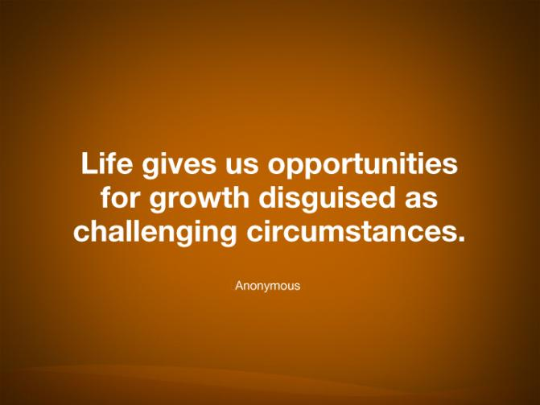




Notes:
Do you have a main point? Consider putting just one word on the slide by itself. Want them to remember a few items? Don’t show everything at once. Instead, show one item at a time. Have a picture that expresses your idea? Scale that picture so that it fills the slide. Have a quote that says it all? Let it say it and remove everything else.

Slide 36

















5
CULTIVATE
HEALTHY
RELATIONSHIPS
Notes:
The last rule is: Cultivate healthy relationships (with your slides and your audience)

Slide 37

Community Development
In order to bring lasting change, we
must first prioritize the things that will
bring about the maximum impact
Then we must organize schedules and
resources that will support the priorities
Finally, we need to mobilize people to be
able to take action and bring
about that change
Notes:
Letting go is hard, we know.

Slide 38

Community Development
In order to bring lasting change, we
must first prioritize the things that will
bring about the maximum impact
Then we must organize schedules and
resources that will support the priorities
Finally, we need to mobilize people to be
able to take action and bring
about that change
Notes:
But don’t hide behind your slides.

Slide 39


Community
Development
In order to bring lasting
change, we
must first
prioritize
the things that will
bring about the
maximum impact
Then we must
organize
schedules and
resources that will
support the priorities
Finally, we need to
mobilize
people
to be able to take
action and bring
about that change
Notes:
Breaking your dependence on your slides can do a world of good for your relationship with your audience.

Slide 40



Community
Development
In order to bring lasting
change, we
must first
prioritize
the things that will
bring about the
maximum impact
prioritize
organize
mobilize
Then we must
organize
schedules and
resources that will
support the priorities
Finally, we need to
mobilize
people
to be able to take
action and bring
about that change
Notes:
Reduce the amount of text to a few key words. Put the rest into your notes.

Slide 41

prioritize
organize
mobilize
Notes:
And practice, practice, practice.

Slide 42



prioritize
organize
mobilize
Notes:
Thinking of your slides as digital scenery,

Slide 43


prioritize
organize
mobilize
Notes:
Allows you to connect eye-to-eye with your audience in a meaningful way.

Slide 44
RULES
TREAT YOUR AUDIENCE AS KING
SPREAD IDEAS AND MOVE PEOPLE
HELP THEM SEE WHAT YOU ARE SAYING
PRACTICE DESIGN, NOT DECORATION
CULTIVATE HEALTHY RELATIONSHIPS
Notes:
So there are the rules.

Slide 45

Notes:
But the question remains—Why go to all this trouble?

Slide 46

Notes:
Why not do it the way you are used to?

Slide 47
Notes:
The answer is simple. Because everyone else does it that way, too. You need to stand apart and be different.

Slide 48
5
RULES
Notes:
When you apply these rules,

Slide 49
Notes:
and keep the audience’s needs top of mind,

Slide 50


prioritize
organize
mobilize
Notes:
your presentation will not only hold their attention,

Slide 51




Notes:
But also change the world. (Well, at least your part of the world.)

Slide 52
www.duarte.com
fiverules@duarte.com
for details about the features used to make this presentation, see next slides
Notes:
For more information, go to www.duarte.com or email us at fiverules@duarte.com.

Slide 53
PowerPoint 2010 Features
Used in This Presentation
Image Enhancement
Transitions
Background removal
Soft edges
Color temperature, saturation
Artistic effects—film grain
Smooth transitions
Custom transition lengths
Video
Graphic Creation
Embed video (default)
Animate (fade) video asset
Place graphics over video
Trim video
Fade in/out
Boolean operations (union/intersection)
3D format—bevel
Wireframe material
Animation
Audio
Variable smooth start/smooth end
Variable end bounce
Animation painter
Change picture
Embed audio mp3s (default)
Play across slides
Fade in/out
Trim audio
Notes:
53

Slide 54







How to Add Natural Animation
With the Animation Bounce End Feature
Click on an animation in the animation pane.
In the pull-down menu, select Effect Options.
In the Effect Options menu, increase
the value for Bounce End.
A higher value will make the animation end
in a longer, bigger bounce while a lower
value will result in a shorter, quicker bounce.
To apply this animation to other items in
your scene, use the Animation Painter to
paint your newly created animation on to
other items.
Put this slide in Slide Show mode to
view an example.
Notes:
54

Slide 55
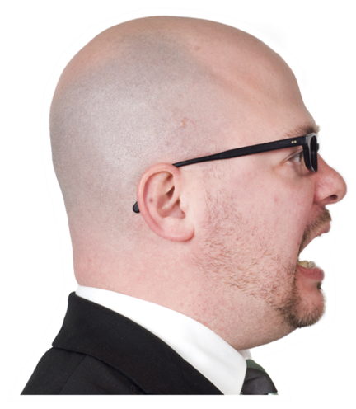
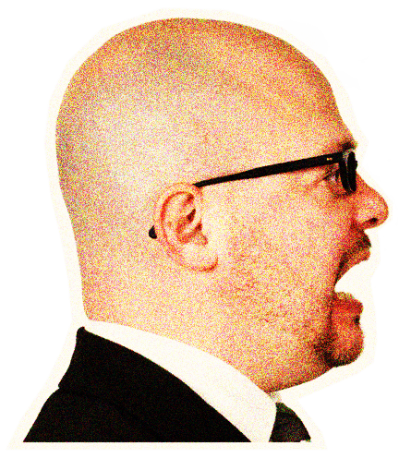
How to Create a Stylized Look
Using the Film Grain Artistic Effect
Right-click on your image and select Format Picture
In Artistic Effects, choose Film Grain
Adjust the values of transparency and grain size to achieve your desired look
In the Picture Color menu, increase the Color Tone Temperature to give the image a warmer feel
Use the Picture Corrections menu to increase the contrast
Finally, add a shadow by going to the Shadow menu, choosing a preset and then modifying until a nice effect is achieved
Try it yourself! See the After version of the image for the values we used to create the film grain look
Before
After
Notes:
55

Slide 56

How to Incorporate Video
With Stylized Effects
In the Insert Tab, click Video/Video from File
Navigate to the location of your video and click Insert
With the video selected, click on the Video Tools\Edit tab at the top
Click on Trim Video to change the start or ending point for your video, consider adding a fade to the beginning or end, and adjust other video options
In the Video Tools\Format tab, choose a poster frame, adjust the color of your video, or add a frame
Consider using the Video Effects menu to put your video into perspective
Examine the properties of this video to see how we used the tools to achieve this look
Notes:
56

